Slide 1
Versioning, Paging, Sorting and Testing

Slide 2
Objectives
Strategies for versioning REST services
Adding pagination capabilities in RESTful web services using Spring Data JPA
Adding sorting capabilities
Tools and libraries for testing RESTful web services

Slide 3
Versioning RESTful APIs with Spring Boot
Why Versioning?
User requirements change over time.
Technology evolves, introducing new possibilities and deprecating old ones.
Maintaining backward compatibility is crucial for existing users.
Versioning allows you to introduce changes without breaking existing clients.
What is API Versioning?
The practice of creating and managing multiple versions of API.
Each version caters to different needs and capabilities.
Allows for gradual updates and smooth transitions for clients.

Slide 4
Popular approaches for API versioning - 1
URI versioning
In this approach, version information becomes part of the URI.
http://api.example.org/v1/users and http://api.example.org/v2/users represent two different versions of an application API.
Use v notation to denote versioning, and the numbers 1 and 2 following the v indicate the first and second API versions.

Slide 5
Popular approaches for API versioning - 2
URI parameter versioning
Pass the version number as a query parameter.
Example: /users?version=1, /users?version=2
Less intrusive on the URI structure.

Slide 6
Popular approaches for API versioning - 3
Accept header versioning
Specify the version in a custom HTTP header.
Example: X-API-Version: 1, X-API-Version: 2
Keeps the URI clean and flexible.

Slide 7
Popular approaches for API versioning - 4
Custom header versioning
Use the Accept header to specify the desired version.
Example: Accept: application/vnd.myapp.v1+json
Leverages existing HTTP mechanisms.

Slide 8
The need for paging
Large datasets: REST APIs often handle vast amounts of data.
Bandwidth limitations: Downloading large datasets can be slow and consume significant bandwidth, especially on mobile devices.
Performance bottlenecks: Retrieving and processing large datasets can strain server resources and impact response times.
UI overwhelm: Displaying massive datasets in a user interface can lead to slow rendering and poor user experience.

Slide 9
What is paging? - 1
Dividing a large dataset into smaller, manageable chunks called "pages."
Clients request data one page at a time.
Improves performance, reduces bandwidth consumption, and enhances user experience.
Benefits of paging
Faster response times: Retrieving smaller pages is quicker.
Reduced bandwidth usage: Only the necessary data is transferred.
Improved scalability: Server resources are used more efficiently.
Enhanced user experience: UI renders faster with smaller data chunks.

Slide 10
What is paging? - 2
Clients can send request paginated data using query parameters:
/employees?page=0&size=10 (first page with 10 items)
/employees?page=1&size=20 (second page with 20 items)
/employees?page=0&size=10&sort=name,asc (sort by name in ascending order)

Slide 11
Spring Data JPA and paging
Spring Data JPA: Provides convenient tools for data access, including the PagingAndSortingRepository interface
The PagingAndSortingRepository provides methods to retrieve entities using the pagination and sorting abstraction. It implicitly provides two methods:
Page findAll(Pageable pageable) – returns a Page of entities meeting the paging restriction provided in the Pageable object.
Iterable findAll(Sort sort) – returns all entities sorted by the given options. No paging is applied here.
Notes:
https://docs.spring.io/spring-data/commons/docs/current/api/org/springframework/data/repository/PagingAndSortingRepository.html

Slide 12
PagingAndSortingRepository
Extends JpaRepository, inherits all the functionality of JpaRepository, including basic CRUD operations and query methods.
Provides methods for sorting data based on properties and directions (ascending/descending).
Main methods:
Page<T> findAll(Pageable pageable): Retrieves a page of data with sorting options.
Iterable<T> findAll(Sort sort): Retrieves all data sorted according to the provided Sort object.

Slide 13
Paging with Pageable interface
Pageable interface: This interface represents pagination parameters such as:
page: page number (starts at 0).
size: number of elements per page.
sort: optional sorting criteria.

Slide 14
Sorting with Sort interface
Sort Interface: This interface represents sorting criteria
by(String... properties): specifies properties to sort by.
ascending(): sorts in ascending order.
descending(): sorts in descending order.

Slide 15
Difference between Page and Slice - 1
Paging: Essential for handling large datasets efficiently in Spring Data JPA.
Page and Slice: Two interfaces representing paginated data with key differences.
Slice interface
Lightweight: only provides information about whether there is a next page or not.
No total count: does not calculate totalElements or totalPages.
Efficient for large datasets: avoids the count query, improving performance for large datasets where the total count is not critical.

Slide 16
Difference between Page and Slice - 2
Page interface provides comprehensive metadata about the paginated data
totalElements: total number of elements in the dataset.
totalPages: total number of pages available.
number: current page number.
size: number of elements per page.
content: Actual data for the current page.
Requires an additional count query to determine totalElements, which can be expensive for large datasets.

Slide 17
Difference between Page and Slice - 3
Feature | Page | Slice
Total elements | Calculated | Not Calculated
Total pages | Calculated | Not Calculated
Has next page | Yes | Yes
Performance | Can be slower for large datasets | Faster for large datasets
Use case | When total count is essential | When total count is not critical

Slide 18
Choosing the Page vs. Slide interface - 1
Choose Page
When need to display the total number of elements and pages in the UI.
When accurate pagination information is crucial for navigation.
Choose Slice
When only need to know if there is more data to load ("Load more" button).
When dealing with massive datasets where the count query is expensive.
When performance is a primary concern.

Slide 19
Choosing the Page vs. Slide interface - 2
// Using Page
Page<Employee> page = repository.findAll(PageRequest.of(0, 10));
// Using Slice
Slice<Employee> slice = repository.findAll(PageRequest.of(0, 10), Sort.by("name"));

Slide 20
Testing for RESTful API - Types of testing
Unit Tests: Focus on individual components in isolation (e.g., controllers, services, repositories). Can use mocking frameworks like Mockito, TestNG , JUnit to simulate dependencies.
Integration Tests: Test the interaction between different parts of your application, including the database and other external services.
End-to-End Tests: Test the entire application flow from the user's perspective, simulating real-world scenarios.

Slide 21
Tools and libraries for testing - 1
Spring Test: Spring Boot's testing framework provides essential annotations and utilities.
@SpringBootTest: Loads the full application context for integration testing.
@WebMvcTest: Focuses on testing Spring MVC components (controllers) with a mocked environment.
@DataJpaTest: For testing JPA repositories.
JUnit 5: The standard for writing unit tests in Java.
Mockito: A powerful mocking framework for simulating dependencies.

Slide 22
Tools and libraries for testing - 2
AssertJ: Provides fluent assertions to make your test code more readable.
MockMvc: Simulates HTTP requests and responses for testing controllers without running a real server.
Rest Assured: A library that simplifies testing RESTful APIs by providing a more expressive DSL.
Testcontainers: Manages external dependencies like databases and message queues within your tests.

Slide 23
Testing Strategies - Controller Tests
Annotate the test class, using @SpringBootTest in the case the full Spring application context loaded for testing.
Use annotation @WebMvcTest for testing controllers
Inject dependencies by using @Autowired to inject any dependencies required for the tests
Write test methods
Create methods for testing.
Use JUnit 5's @Test annotation to mark test methods.
Write assertions to verify the expected behavior of the code.

Slide 24
Testing Strategies - Service Tests
@SpringBootTest: This annotation loads the full Spring application context, allowing you to inject and test the EmployeeService with all its dependencies.
@Autowired: Injects the service bean into the test class.
Write test methods
Create methods for testing.
Use JUnit 5's @Test annotation to mark test methods.
Write assertions to verify the expected behavior of the code.

Slide 25
Testing Strategies - Repository Tests
@DataJpaTest: This annotation configures an embedded database and sets up a Spring Data JPA slice for testing. It focuses only on JPA components, making the tests faster.
@Autowired: Injects the repository bean into the test class.
Write test methods
Create methods for testing.
Use JUnit 5's @Test annotation to mark test methods.
Write assertions to verify the expected behavior of the code.

Slide 26
Demo - Spring REST Paging, Sorting, Testing
Step 1. Project Setup
Create a Spring Boot Project includes the following dependencies:
Spring Web, Spring Data JPA, Springdoc-openapi-ui (for API documentation)
Set up the Model: Create a Employee class
Create the Repository: Create an interface IEmployeeRepository extending PagingAndSortingRepository from Spring Data JPA.
Implement the Service: Create an interface IEmployeeService and its implementation EmployeeService.
Create the Controller: Create a EmployeeController class to handle RESTful API requests.

Slide 27
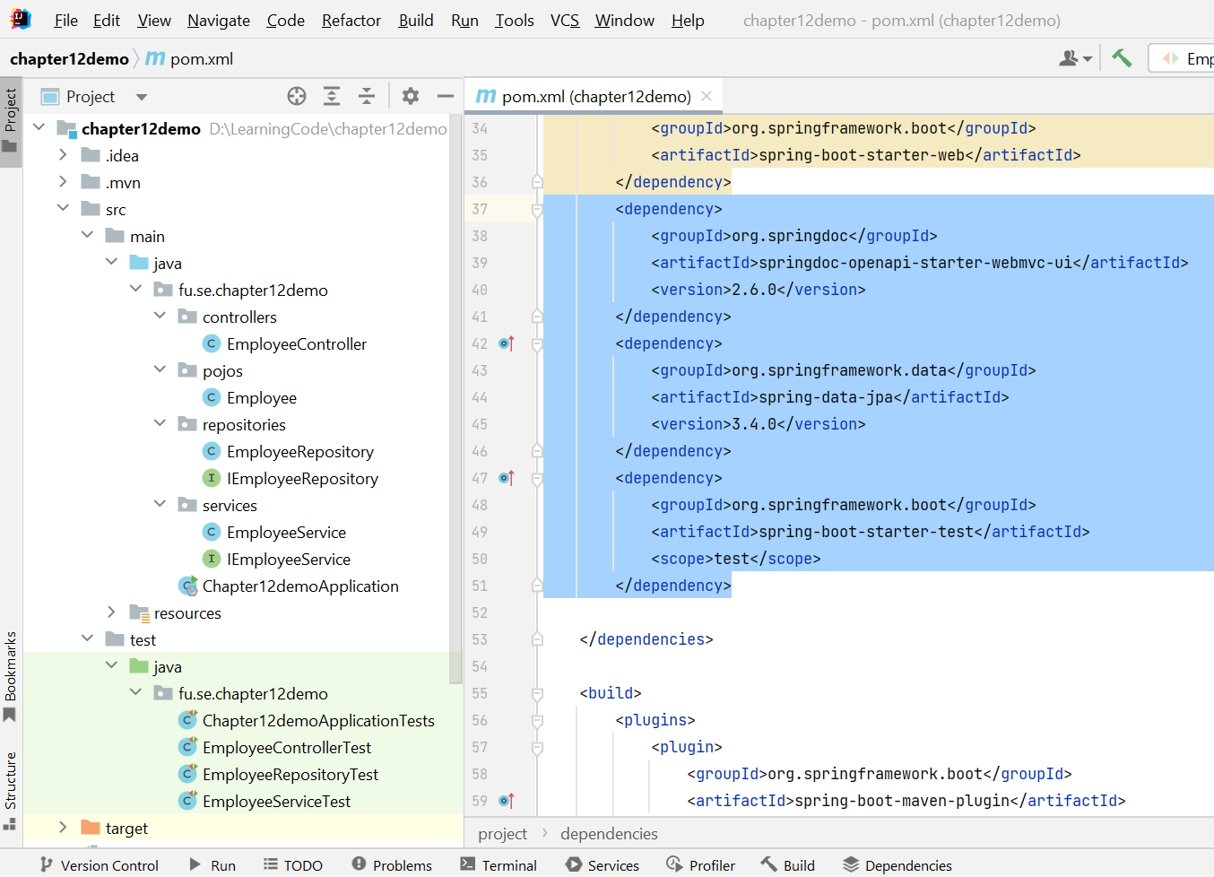
Demo - Spring REST Paging, Sorting, Testing

Slide 28
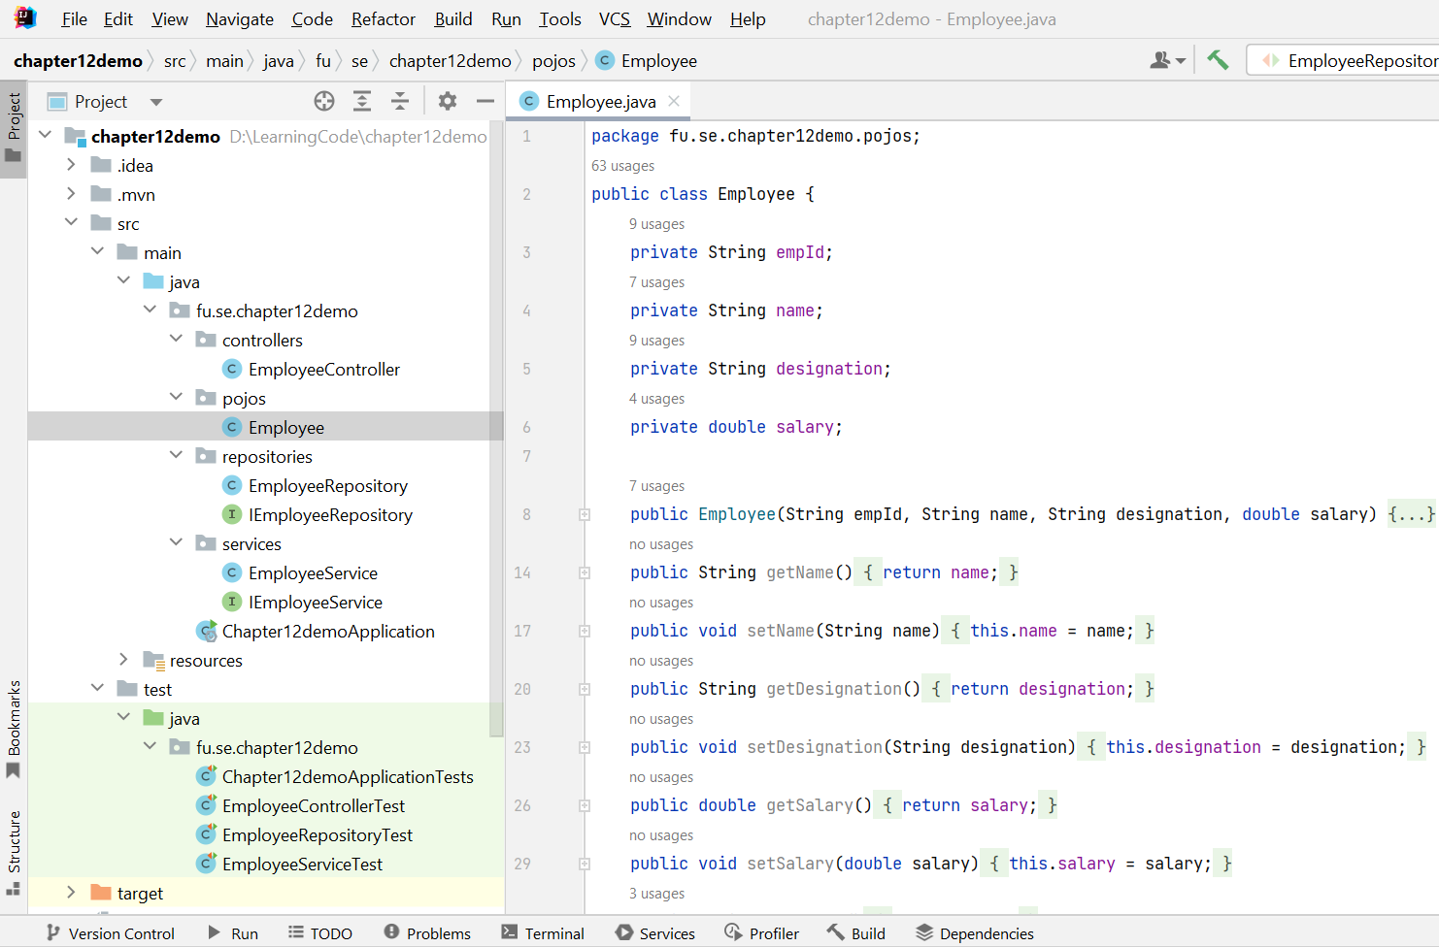
Demo - Spring REST Paging, Sorting, Testing

Slide 29
Demo - Spring REST Paging, Sorting, Testing
Step 2. Implementation Repository
Inject the EmployeeRepository into your EmployeeService.
Implement methods for basic CRUD operations
For in-memory paging and sorting without a database, override the findAll(Pageable pageable) method.

Slide 30
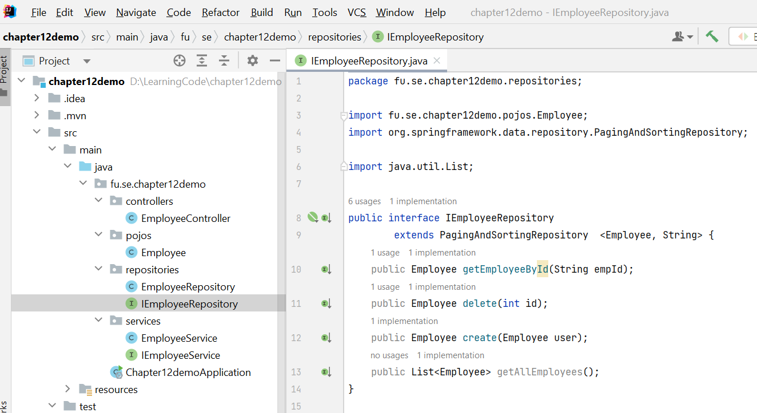
Demo - Spring REST Paging, Sorting, Testing

Slide 31
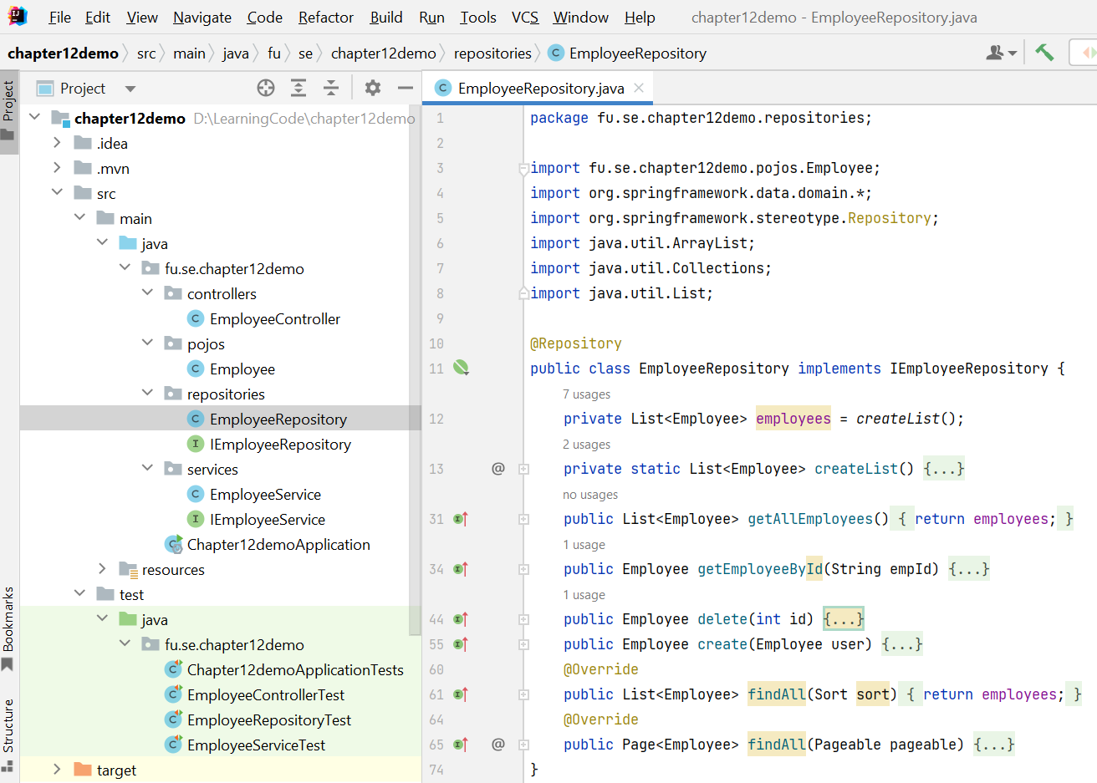
Demo - Spring REST Paging, Sorting, Testing

Slide 32
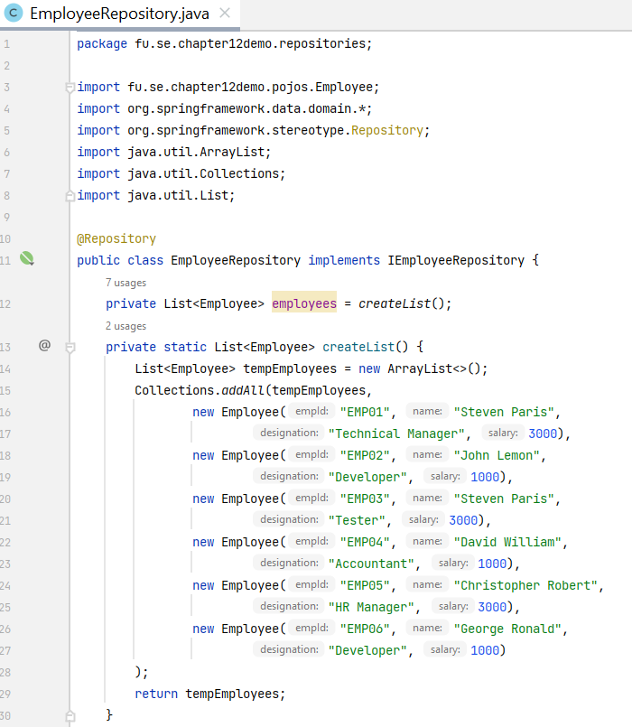
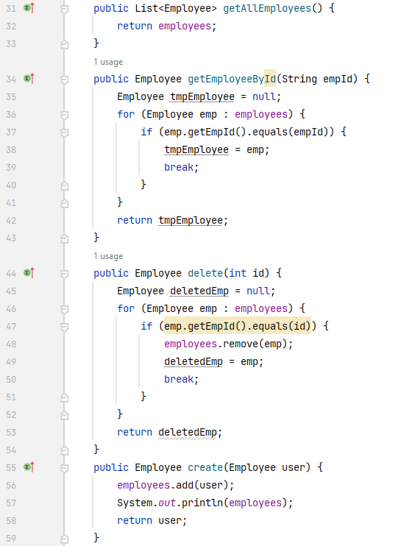
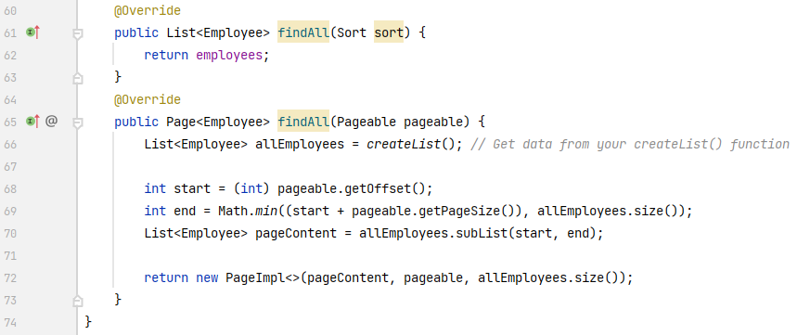
Demo - Spring REST Paging, Sorting, Testing

Slide 33
Demo - Spring REST Paging, Sorting, Testing
Step 3. Implementation Service
Implement business logic in your service methods.
Use the EmployeeRepository to interact with the data layer.

Slide 34
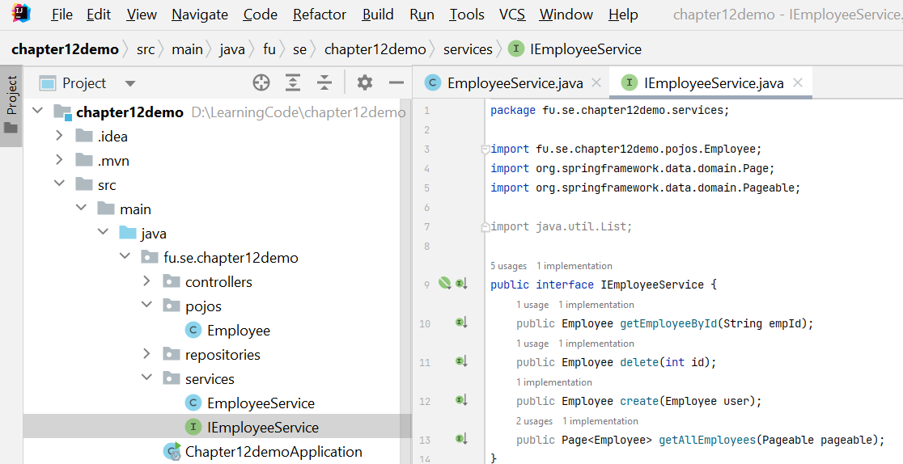
Demo - Spring REST Paging, Sorting, Testing

Slide 35
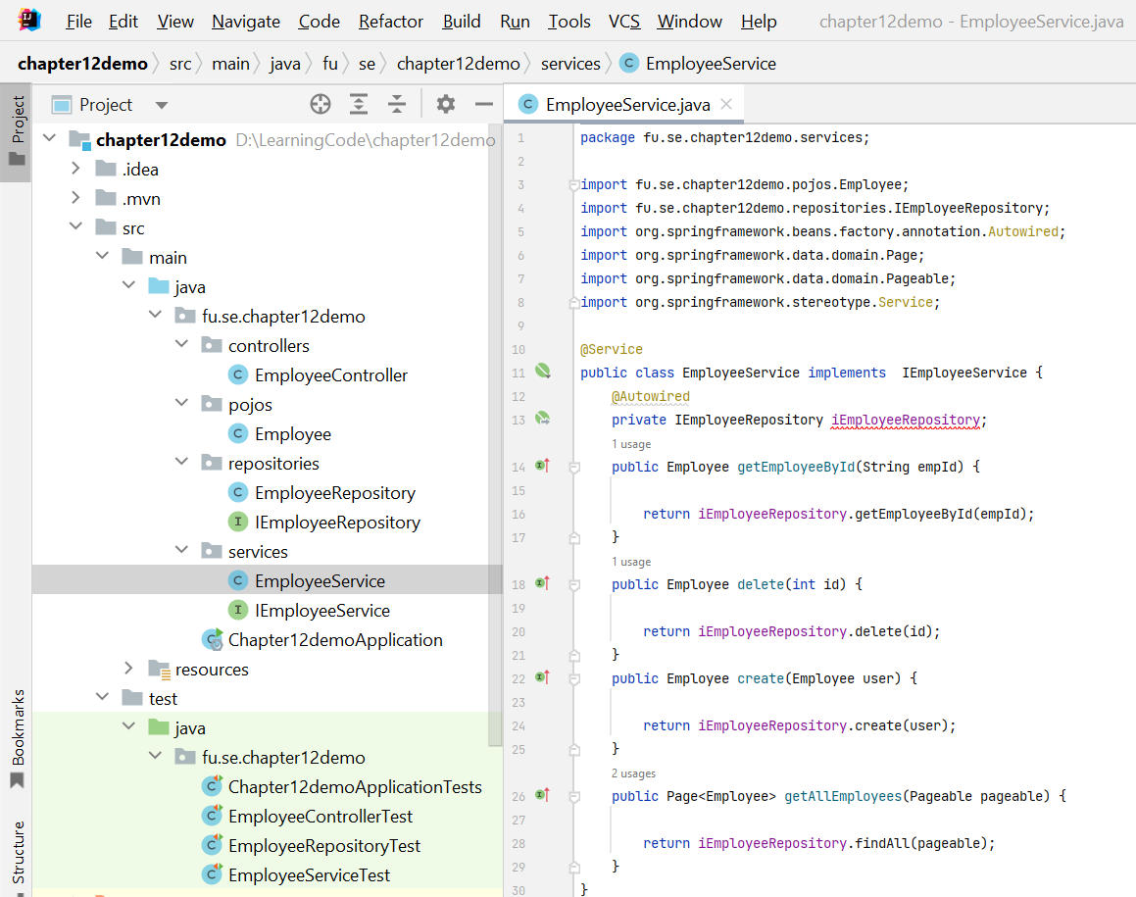
Demo - Spring REST Paging, Sorting, Testing

Slide 36
Demo - Spring REST Paging, Sorting,Testing
Step 4. Implementation Controller
Use @RestController to define your REST controller.
Use @GetMapping, @PostMapping, @PutMapping, @DeleteMapping for different HTTP requests.
Use Pageable in your controller methods to handle paging and sorting parameters.

Slide 37
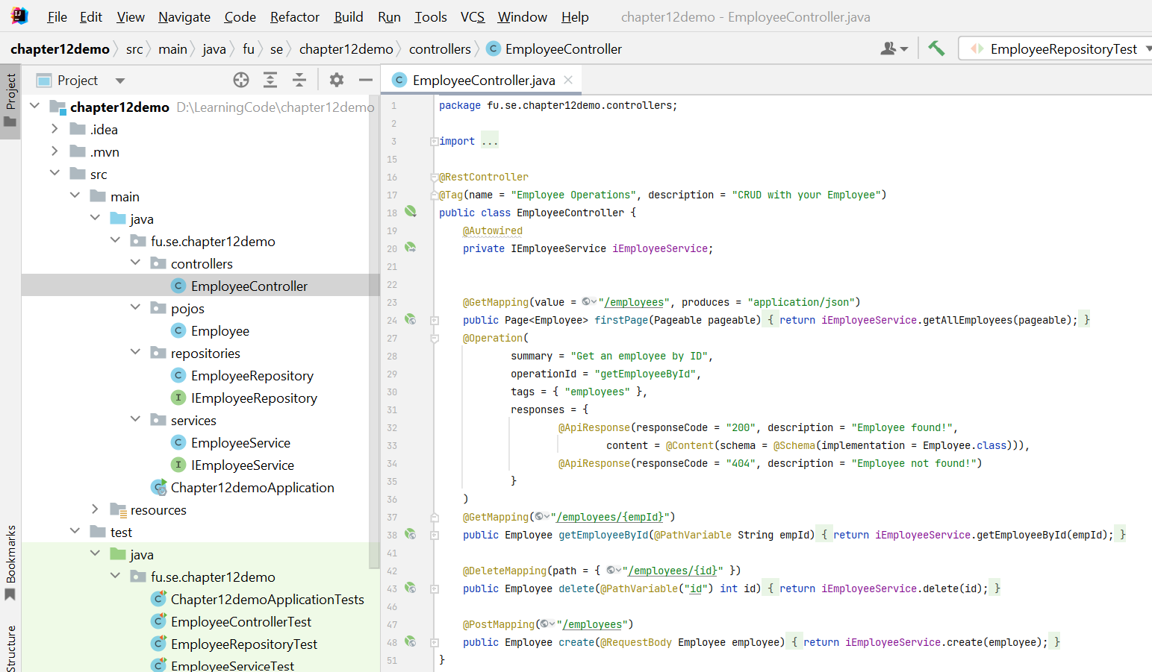
Demo - Spring REST Paging, Sorting, Testing

Slide 38
Demo - Spring REST Paging, Sorting,Testing
Step 5. Testing
Add dependencies: Include spring-boot-starter-test, JUnit 5, Mockito, and AssertJ in pom.xml file.
Write tests
Create test classes for your controller, service, and repository.
Use @WebMvcTest for controller tests with MockMvc.
Use @SpringBootTest for integration tests involving the full application context.
Use @DataJpaTest for repository tests with an embedded database.

Slide 39
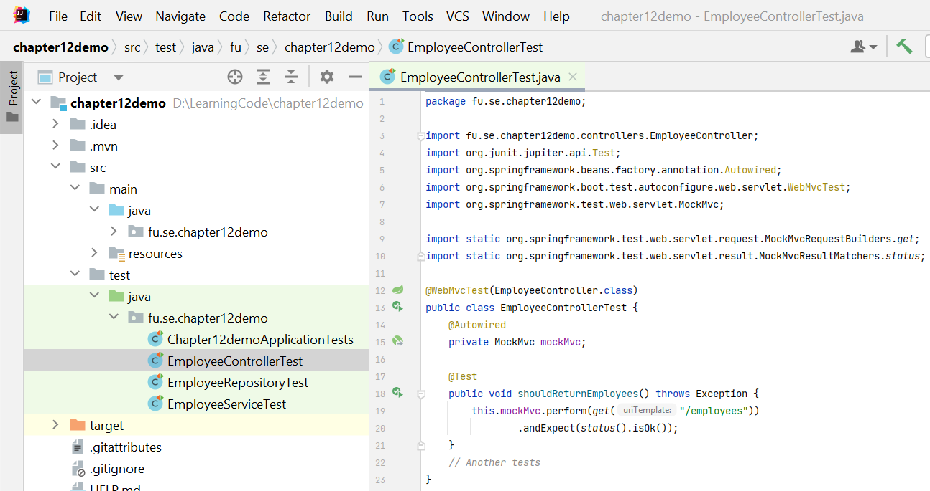
Demo - Spring REST Paging, Sorting, Testing

Slide 40
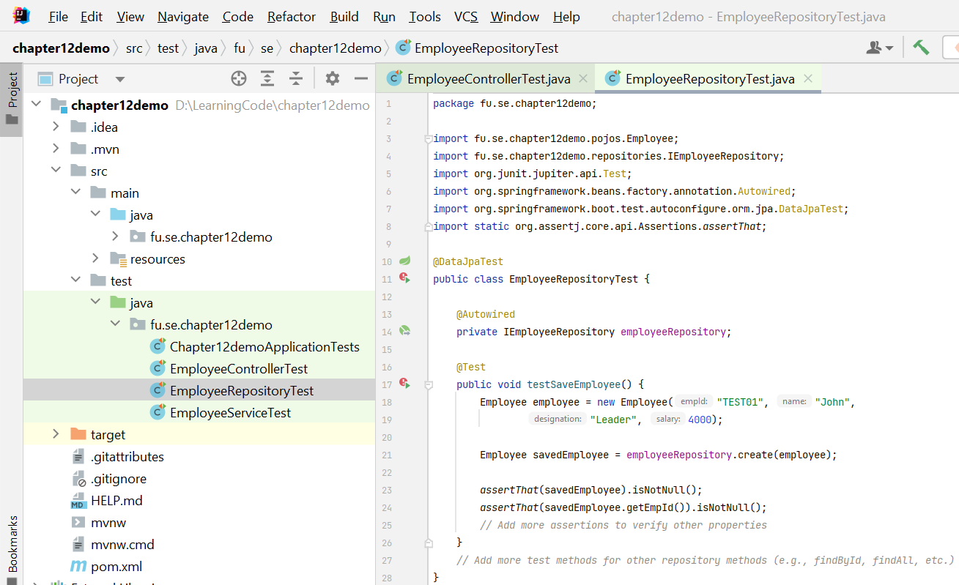
Demo - Spring REST Paging, Sorting, Testing

Slide 41
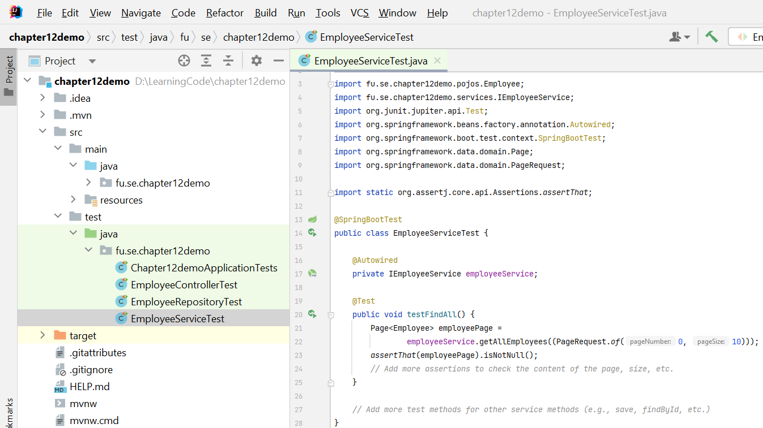
Demo - Spring REST Paging, Sorting, Testing

Slide 42
Summary
Concepts were introduced:
Strategies for versioning REST services
Adding pagination capabilities in RESTful web services using Spring Data JPA
Adding sorting capabilities
Tools and libraries for testing RESTful web services

